Slide 1

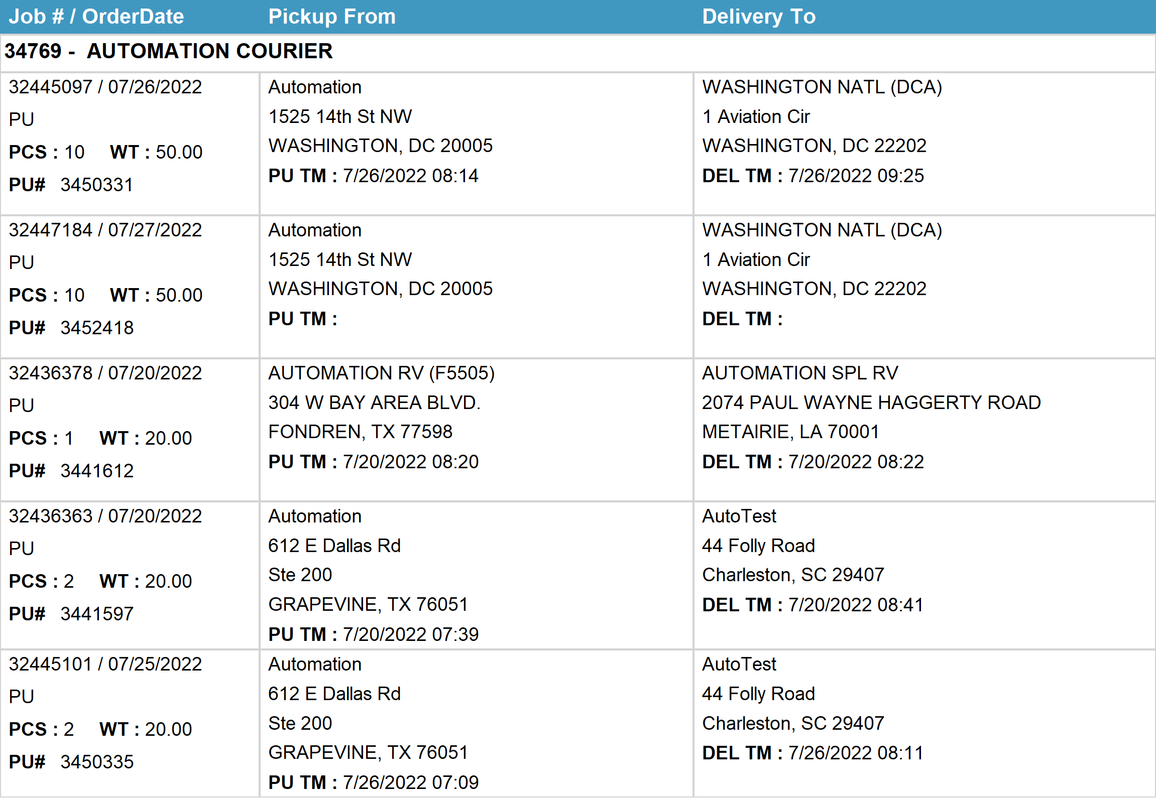
Agent Activity Report
*Data provided should be considered CONFIDENTIAL and PROPRIETARY*
©2011-2022 MNX Global Logistics. All rights reserved.
7/28/2022 9:06 PM
Print User : automation

Slide 2
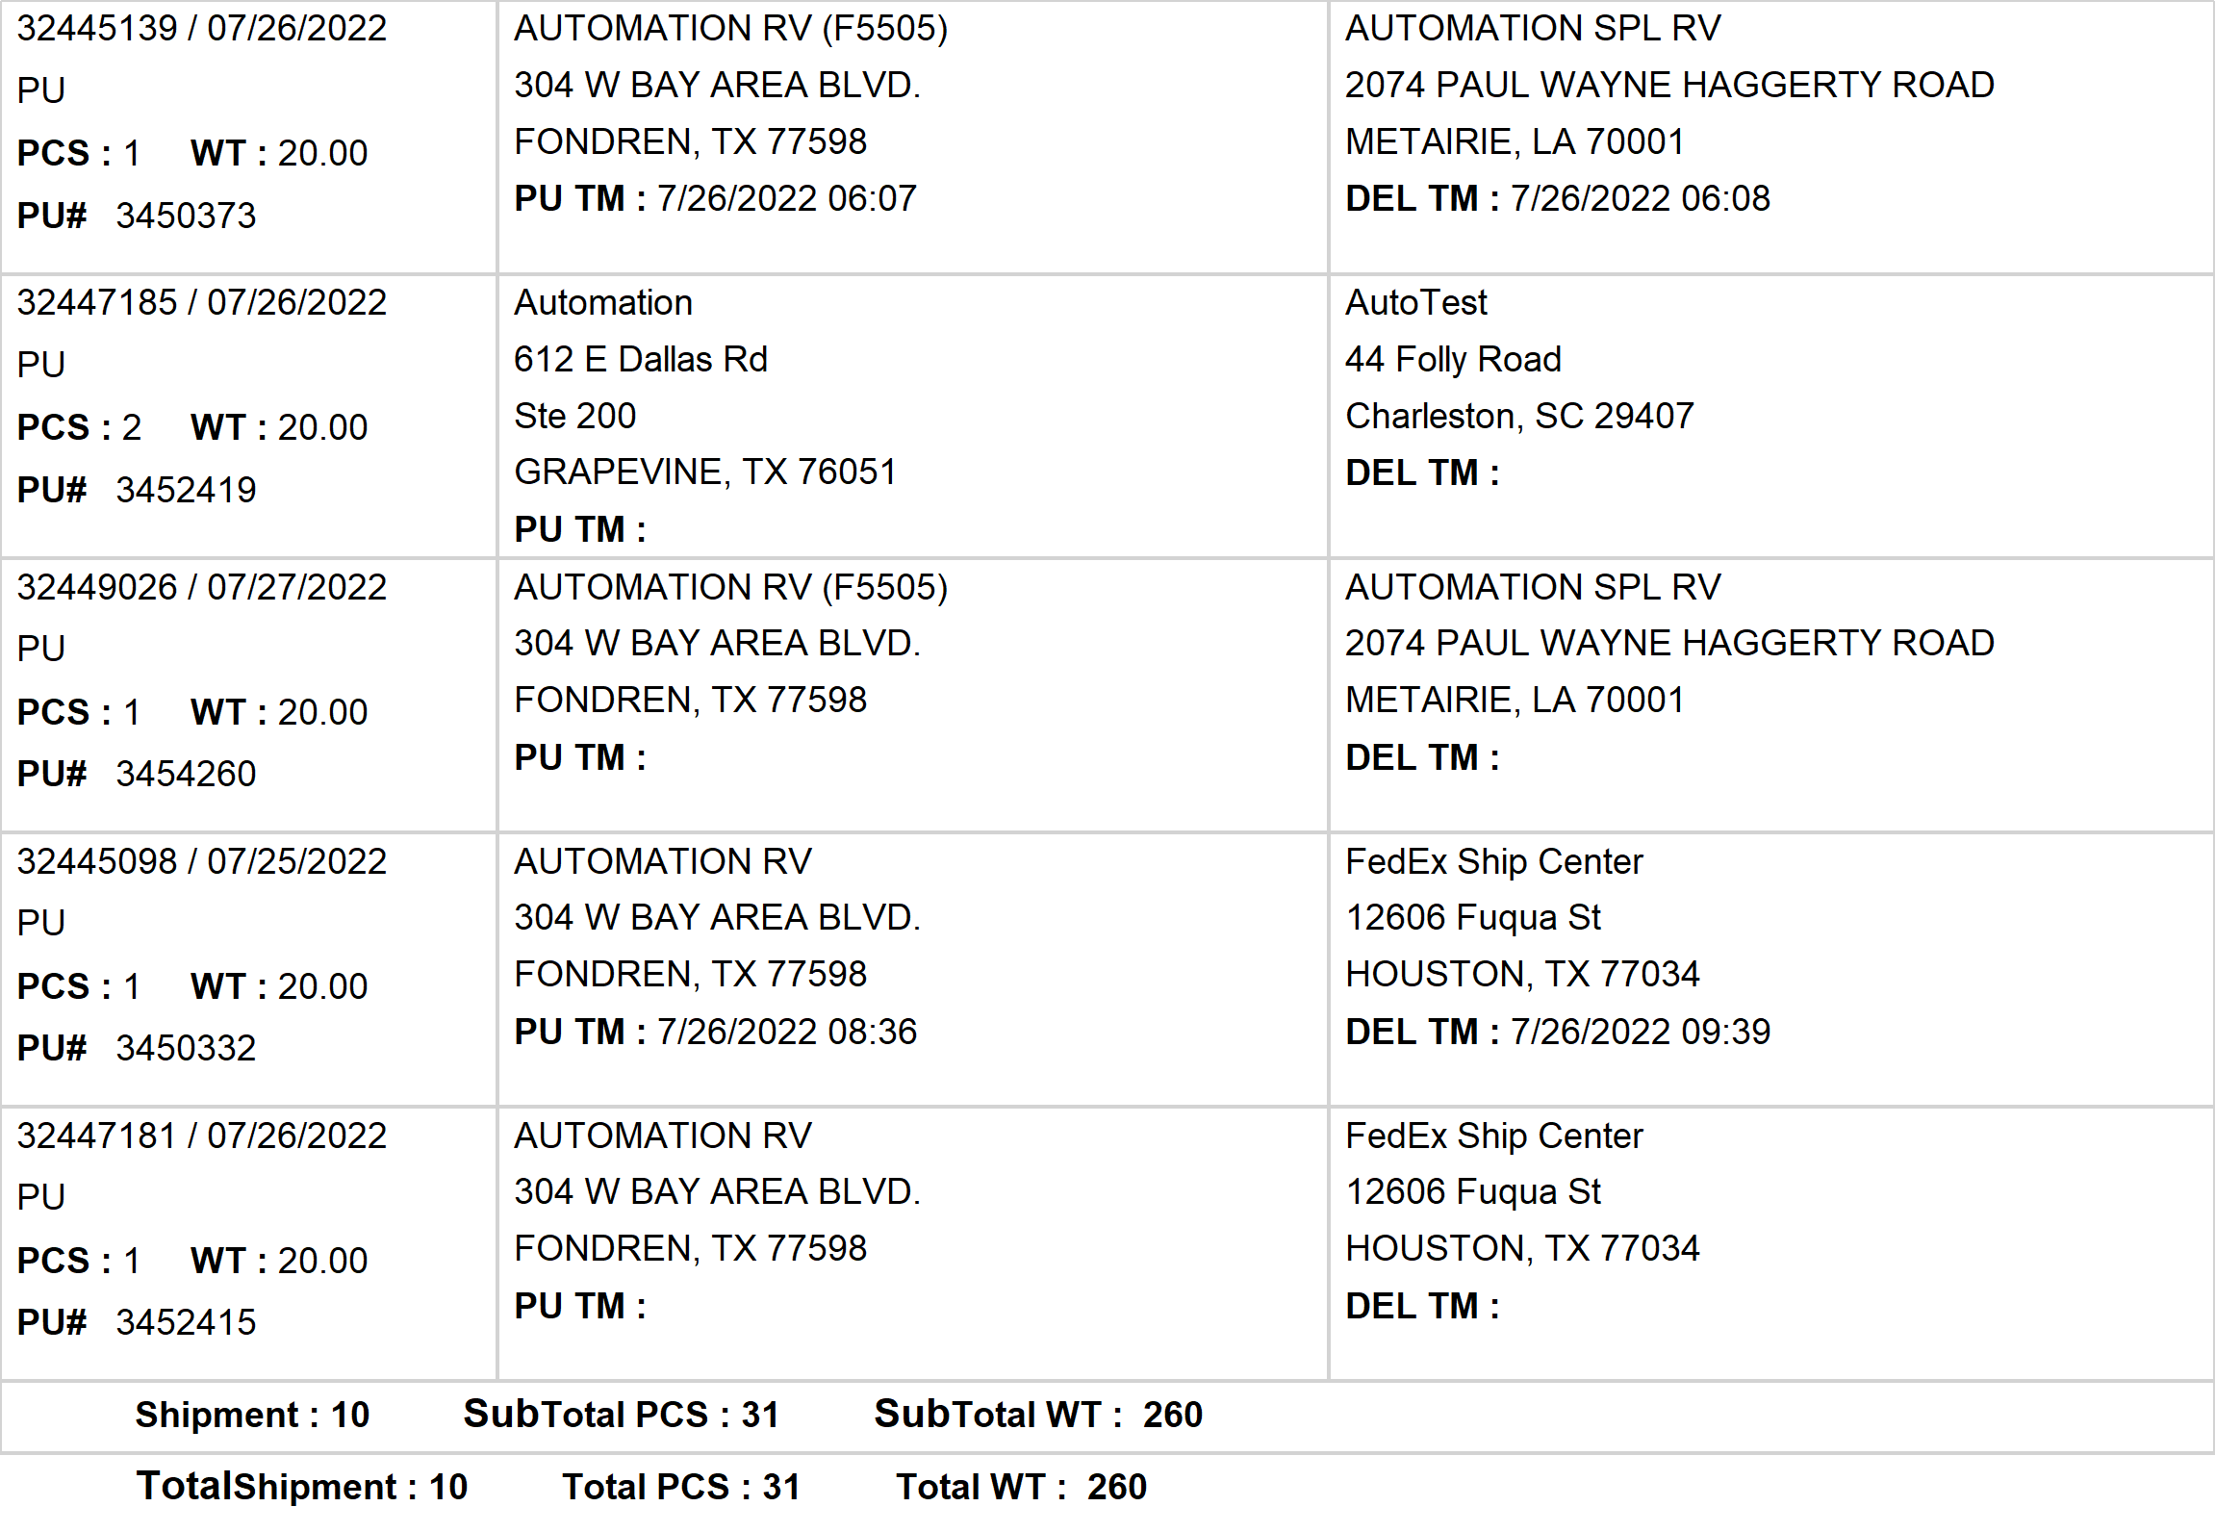
Agent Activity Report
*Data provided should be considered CONFIDENTIAL and PROPRIETARY*
©2011-2022 MNX Global Logistics. All rights reserved.
7/28/2022 9:06 PM
Print User : automation

